Slide 1
Programming with
Blockly C++
Developed by
Chris Haidas
Jonathan White
Christopher Lindberg

Slide 2
The Purpose of Blockly C++
The difficulty of C++.
Complicated syntax
Explicit types
Scopes
How does C++ relate to other programming languages?
C++ vs Python
How do beginners see C++?
Beginner programmers vs programmers learning C++
Notes:
Introduction, why Blockly C++ exists
Why do we want to use Blockly for C++ to begin with?
C++ is complex, the syntax is complex and is hard to grasp for new users
We want to simplify that and make it easier for beginners to understand and grasp the basic concepts in c++, without getting hung up on minor syntax errors, type errors, and scope errors.
And while more experienced programmers who may not know c++ can grasp the basic concepts, making even a single error with syntax or structure can cause your program to not run, which makes it frustrating for people unfamiliar with the syntax
The easiest way to see just how complex C++ is when compared to other programming languages would be to compare it to a programming language like python.

Slide 3
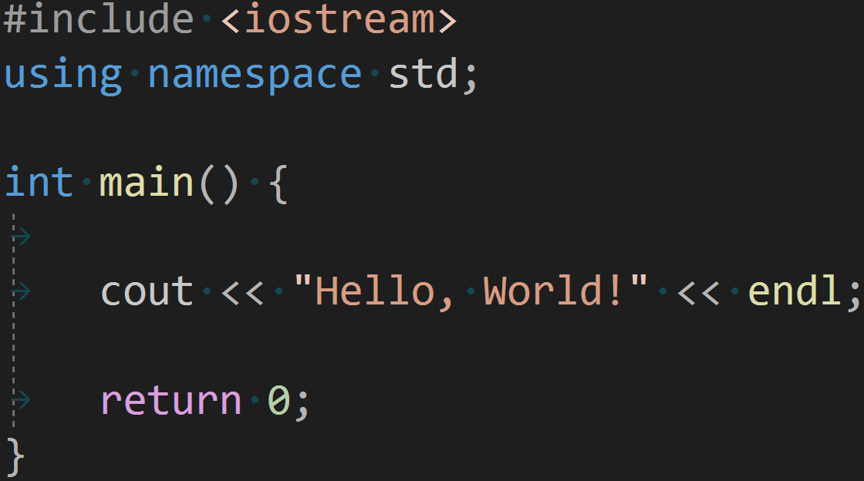

C++ vs Python: “Hello, World!”
More verbose syntax
Inherently more complex
What does everything mean?
More succinct syntax
Inherently simpler
“Print” makes intuitive sense.
Notes:
Specifically outline the difference between how these work.

Slide 4
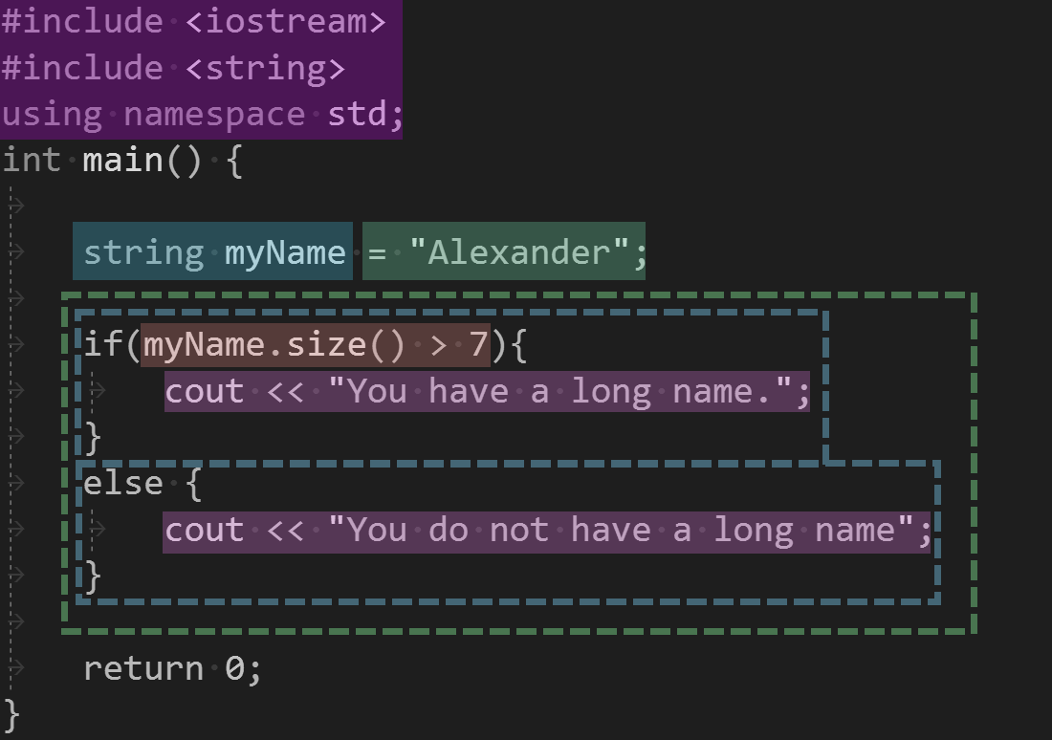
The Structure of Code
Code can be seen as “blocks”.
Different “blocks”
C++ can be seen as “blocks”
Different “blocks” have different logic
Preprocessors
If, else if, else
Boolean checks
Cout
Notes:
Here, we can talk about how these blocks are analogous to blocks in blockly. Mention how blocks that work with each other or do similar things can have the same colors, like in this picture.
The bullet points (preprocessors… etc) are examples of blocks that have similar categories. Talk about how each block of color has a corresponding block.

Slide 5

Working with Blockly C++
Simplifies syntax
Applies structure
I.e. Uninitialized constants
Correct code generation
Categorization of syntax
Notes:
Explain while video is playing. Mention how blockly simplifies code by

Slide 6
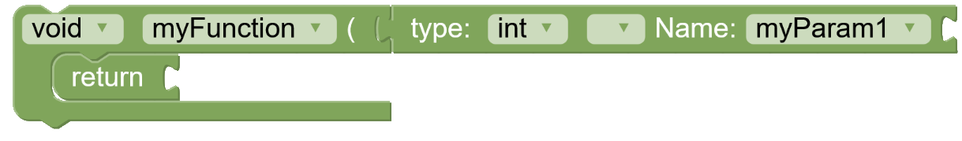
Development of UI design
Many separate pieces
What goes where?
Difficulty to understand each piece separately
Why can I return “int myParam1”
Problems in logic and code generation
Notes:
Talk about the importance of our UI design. Using an separate block to handle a function parameter is confusing and is opening the user to error.
For example, the user may be able to drag the parameter block into the return, which will cause errors.
Too many separate blocks can cause confusion for the user, especially about knowing what block goes where?

Slide 7
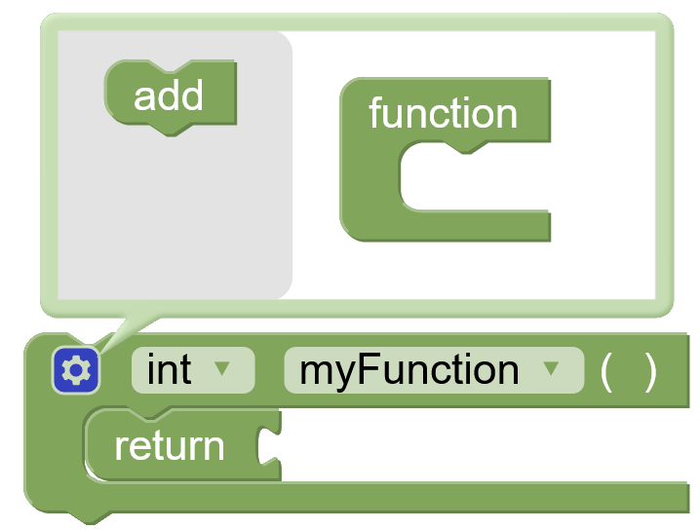
Development of UI design (Cont.)
Contained pieces
Function parameters are in the function block
Easy to disambiguate
Less error in code generation
Automatic handling of logic
Notes:
It makes sense for the function parameters to be handled by the function itself.
One less thing you have to worry about. -> automatic handling of logic
Focused on UI development so it makes intuitive sense i.e declaring parameters

Slide 8
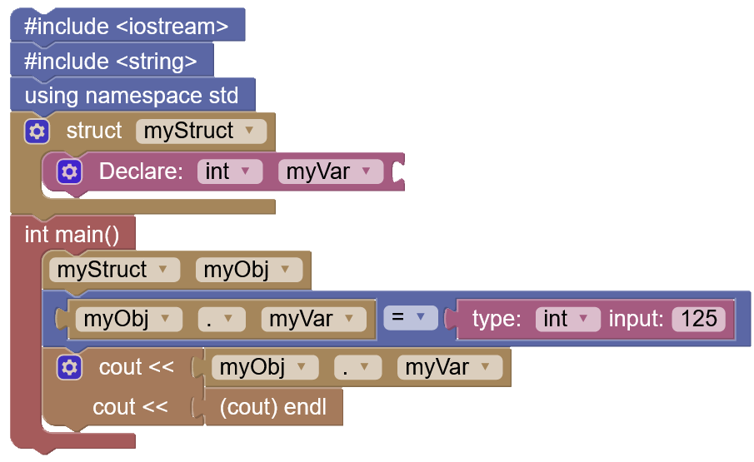
Behind the Scenes
Blocks are nodes in a tree
Two connected blocks are parent and child nodes
Blocks are able to share data between each other
Notes:
Begin to talk about algorithms, mention the forms of information in the above block workspace.
Then, transition to talk about how Blockly is a n-ary tree.
Talk about what an N-ary Tree is.
Mention how easy it is to traverse through the tree to grab whatever information we want by using recursion.
Mention how the myObj.myVar at the bottom left of the tree traverses up to myStruct my Obj, then to struct myStruct, then to int myVar. Mention how we made a class to traverse through this tree to get the information we want.
This slide should not take very long.

Slide 9
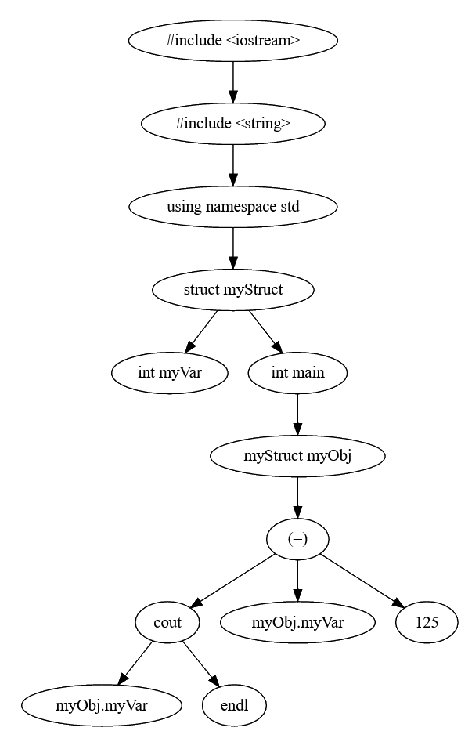
Behind the Scenes
Uses N-ary Tree
Traversal using recursion
Used to allocate
Scopes
Declarations
Multi-block errors
Notes:
Here, we can talk about how these blocks are analogous to blocks in blockly. Mention how blocks that work with each other or do similar things can have the same colors, like in this picture.
The bullet points (preprocessors… etc) are examples of blocks that have similar categories. Talk about how each block of color has a corresponding block.

Slide 10
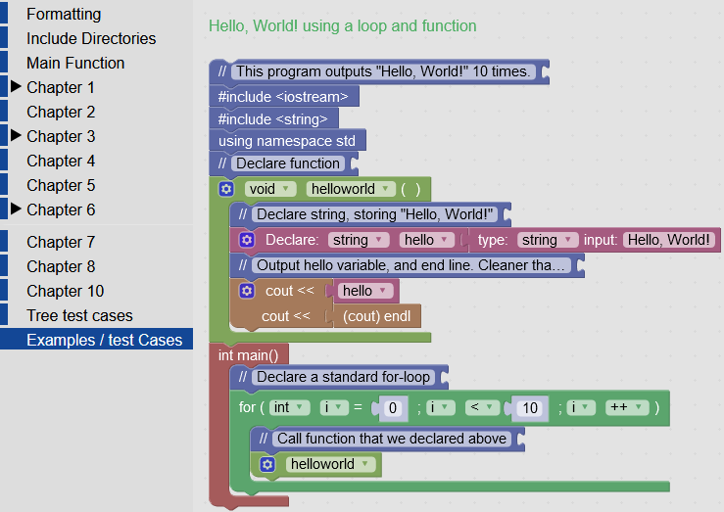
Blockly in Practice
Built-in examples
Each example showcases chapter-specific concepts
Additional help
Blocks can have direct access to C++ guides
Tooltips can describe the specific function of a block

Slide 11
Future Plans
Development spanning several semesters
Requires proper feedback
First Year Students
Beta testing
Upcoming features
Planned redevelopment of variable system
Proliferation of Advanced Checking
Notes:
Talk about how

